Slide 1
College: 513 modules
203 modules that are not thesis modules or placements and do not have a “Examination”, “Studio Examination”, “Practical Examination” or “Oral Examination” components (39.57%)
E&E: 11
Mech: 32
Civil: 18
APEP: 96
BFE: 22
CBE: 24
The following breakdown of modules excludes:
Modules worth at least 20 credits.
Modules that have been identified as thesis/dissertation/research project modules.
Work placement modules.
Modules that have a non-zero weighting on “Examination”, “Studio Examination”, “Oral Examination” or “Practical Examination” components.

Slide 2
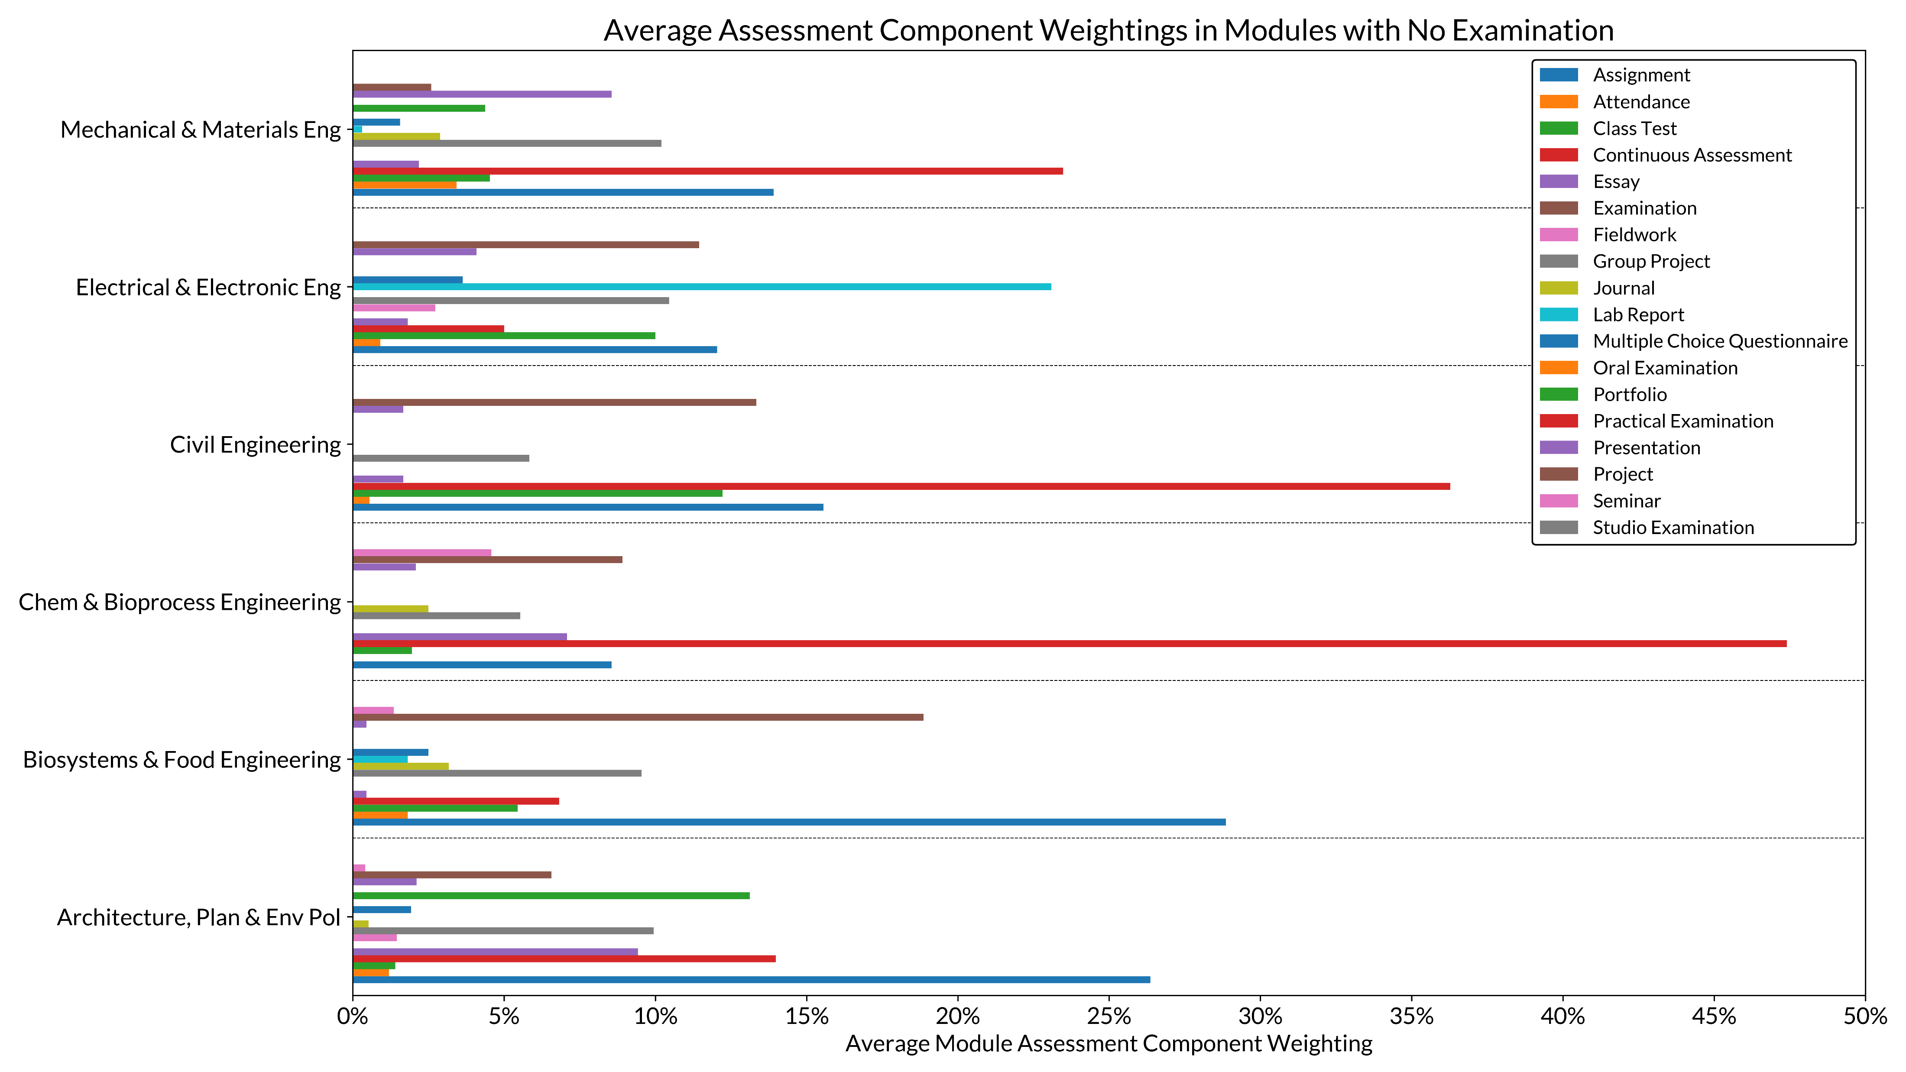

Slide 3
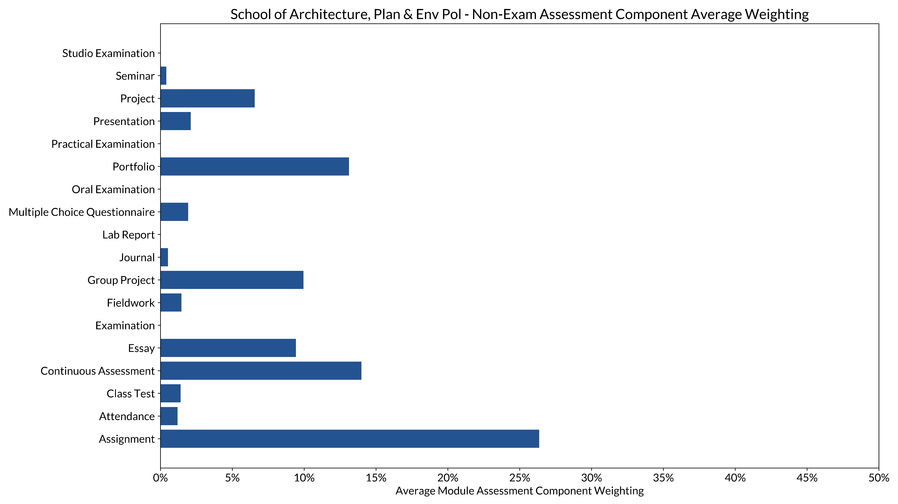

Slide 4
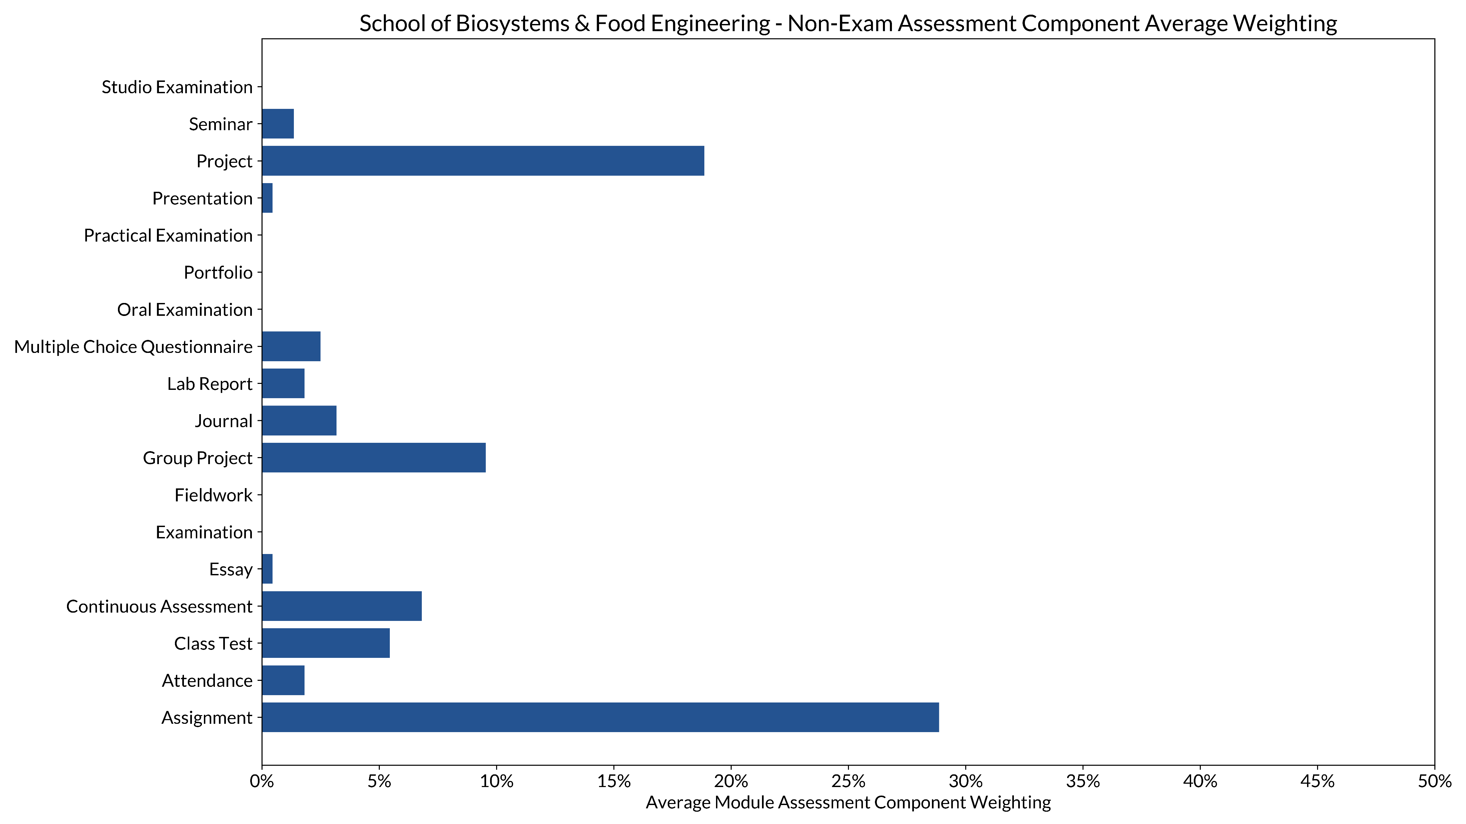

Slide 5
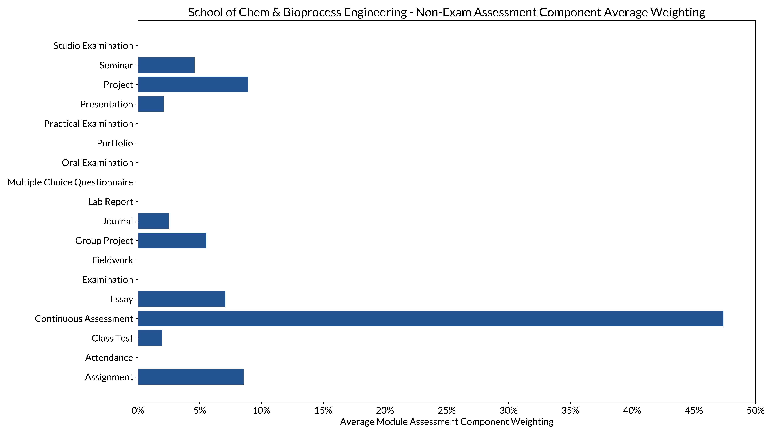

Slide 6
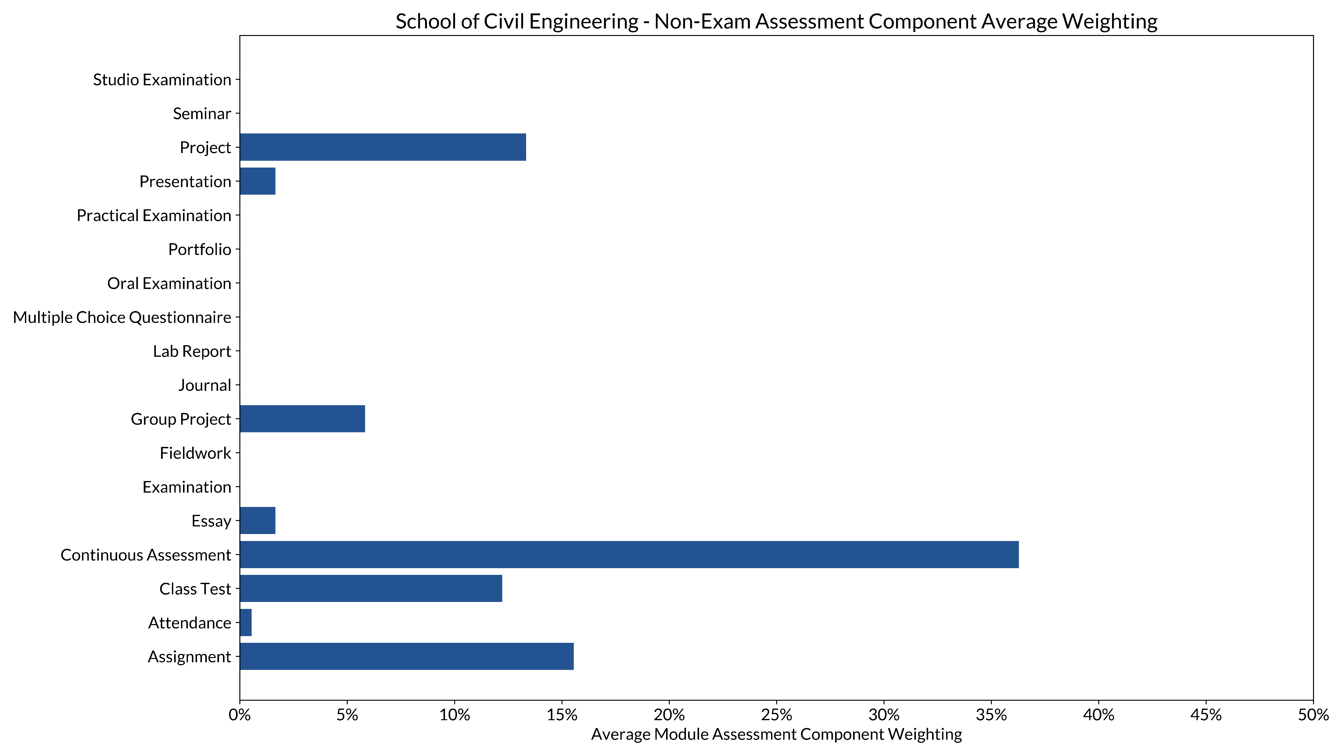

Slide 7
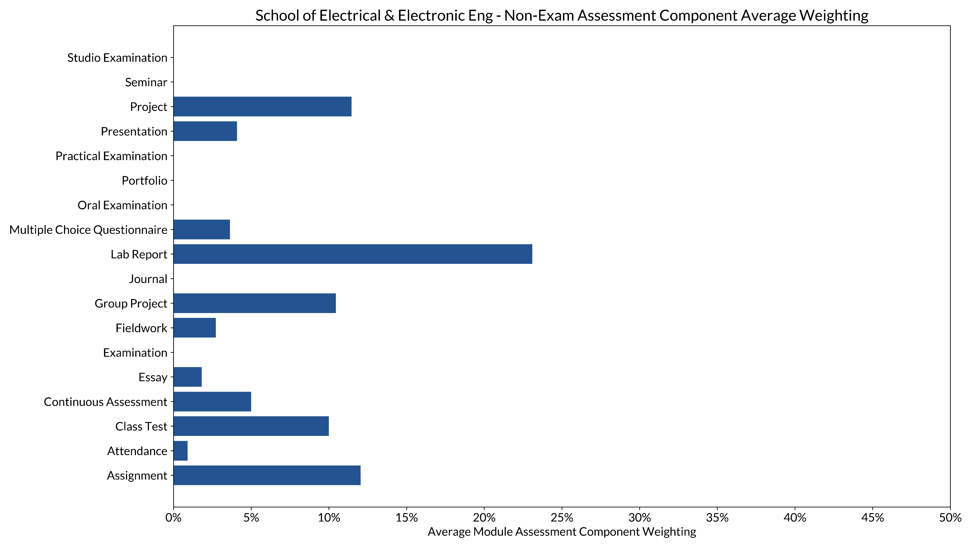

Slide 8
